Slide 1
Adapter Framework
Mumbai, Aug-2019, Nikhil

Slide 2
Table of contents
SAP PO Adapter Framework Overview
1
Technical adapters in detail
2

Slide 3
Structure of the Adapter Framework
The Adapter Framework is part of the Adapter Engine and the Advanced Adapter Engine Extended. It provides interfaces for configuring, managing, and monitoring adapters. PI connects to any external systems using the Adapter Framework.
The Adapter Framework is based on the AS Java runtime environment and the Connector Architecture (JCA) version 1.0.
The Adapter Framework executes the communication between any SAP or non-SAP systems.
In the figure in the next slide, the Integration Server, Integration Directory, System Landscape Directory, Runtime Workbench, and Enterprise Services Repository are shown on the left. The Adapter Framework and its modules are shown in the middle and the external system to be connected is on the right.
Examples of external systems:
An ERP system such as Peoplesoft
A CRM system such as Siebel
A data pool such as UCCnet
A Web service
An EDI subsystem

Slide 4
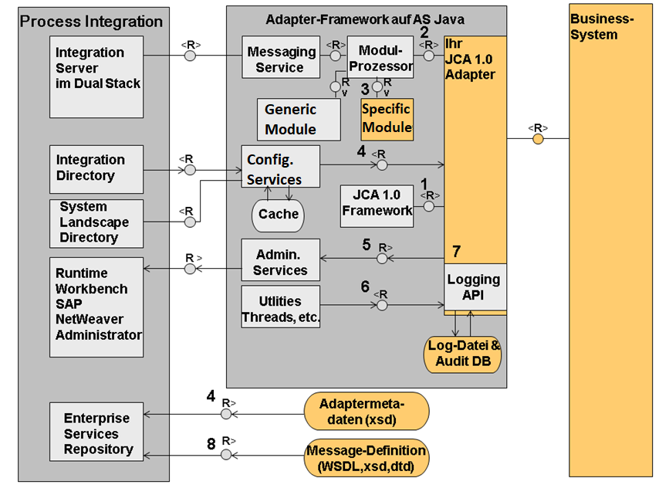

Slide 5
Functions in the Adapter Framework
The JCA 1.0 container of AS Java uses the JCA 1.0 Service Programming Interface (SPI) to exchange server-relevant information with the adapter according to JCA 1.0 (1).
The adapter must be a JCA 1.0-compliant resource adapter. JCA 1.0 does not define the communication direction from the adapter to the Adapter Framework (application in the JCA sense). Therefore, the Adapter Framework is called by the adapter with a standard Enterprise JavaBean 2.0 session bean.
The Adapter Framework communicates using JCA 1.0 connections (2) and the JCA 1.0 Common Client Interface (CCI) with an adapter.
A message that comes to a dual-stack PI system from the Integration Server or to the Advanced Adapter Engine Extended from an external system is received by the messaging service in the Adapter Framework. Based on the receiver information, the corresponding module chain in the module processor is selected for further processing.

Slide 6
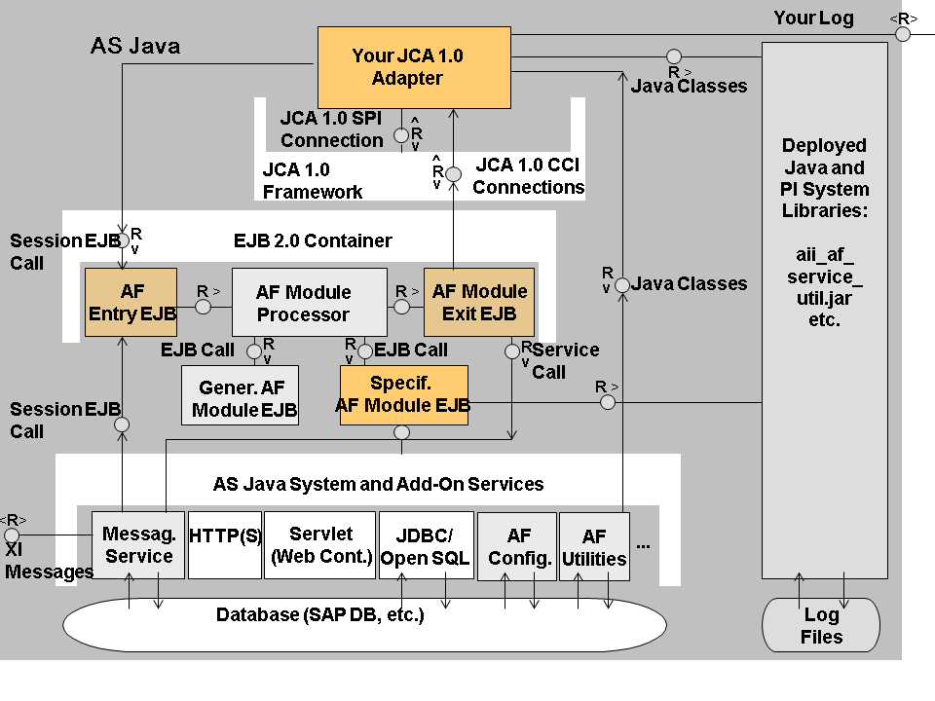

Slide 7
The Adapter Framework consists mainly of Enterprise JavaBeans. As a rule, these are stateless session beans. They communicate with the adapters using the Enterprise JavaBeans container and the JCA framework.
There are two ways to convert the external protocol to XI message protocol:
Execute the entire protocol mapping in the JCA adapter
Execute parts of the mapping in the Enterprise JavaBeans that are embedded in the module processor.
Module Processor
The module processor (AF module processor in the graphic) controls the processing sequence of the module. The modules are called in the sequence as they are entered in the module processor of the communication channel.
If an exception is triggered at runtime, processing is stopped and the exception trigger is informed.

Slide 8
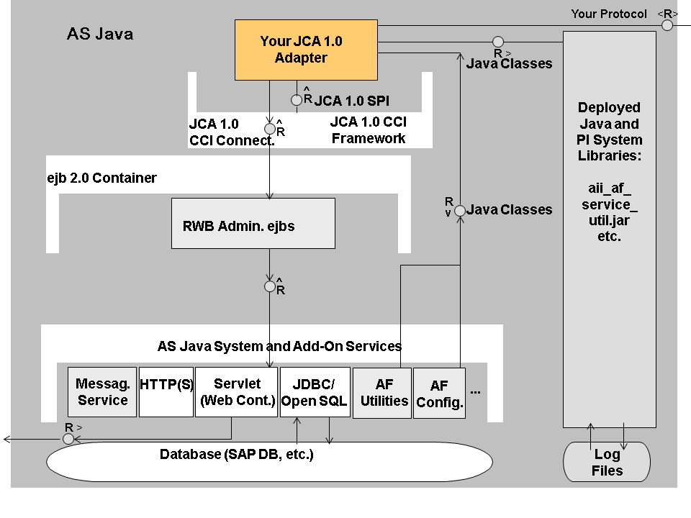

Slide 9
The figure in the previous slide shows the services, in particular the configuration, administration, and logging interfaces. The configuration interfaces allow access in two directions to read the configuration data. All other interfaces only function in one direction.
The figure does not show the loading of the message metadata, as this is a manual process that is triggered by the Integration Directory.

Slide 10
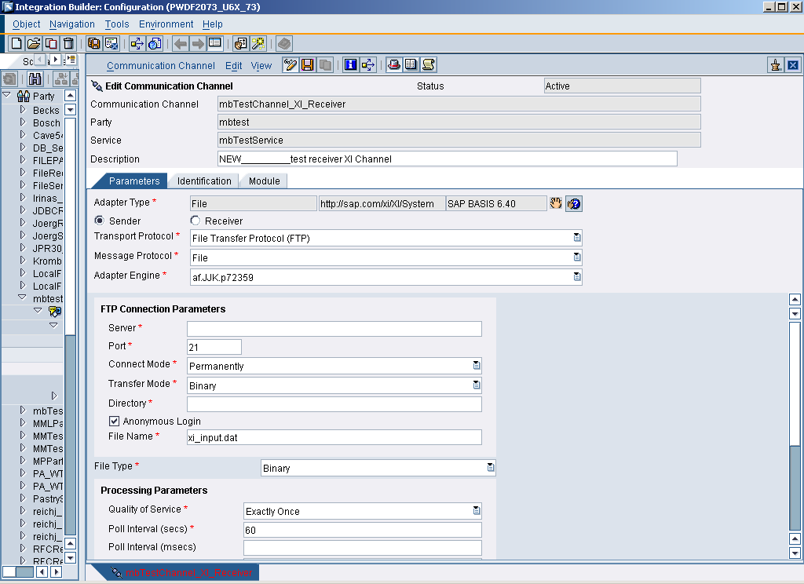
Adapter Configuration
Adapter independent parameters
Adapter specific parameters

Slide 11
Quality of Service (QoS)
The sender of a message uses the attribute Quality of Service (QoS) to determine how a message is delivered. The following types of quality of service are supported:
● BE (Best Effort): The message is sent synchronously. The sender waits for a response before it continues processing.
● EO (Exactly Once): The message is sent asynchronously. The sender does not wait for a response. The Integration Engine and the Adapter Engine guarantee that the message is sent and processed exactly once.
● EOIO (Exactly Once In Order): Messages are delivered with the same queue names (supplied by the application) in the same sequence that they were sent from the sender system. Message processing is asynchronous in this case.
In the case of quality of service BE an error occurs if more than one receiver is determined for a message. In the case of delivery types EO and EOIO, the message is copied correspondingly and sent to the individual receivers.
Synchronous Message Processing (BE)
Asynchronous Message Processing (EO, EOIO)

Slide 12
Technical Adapters in Detail
This section will give an overview of the functionality and usage of each technical adapter delivered with PO
RFC
IDoc
File
JDBC
JMS
Plain HTTP
SMTP
SOAP

Slide 13
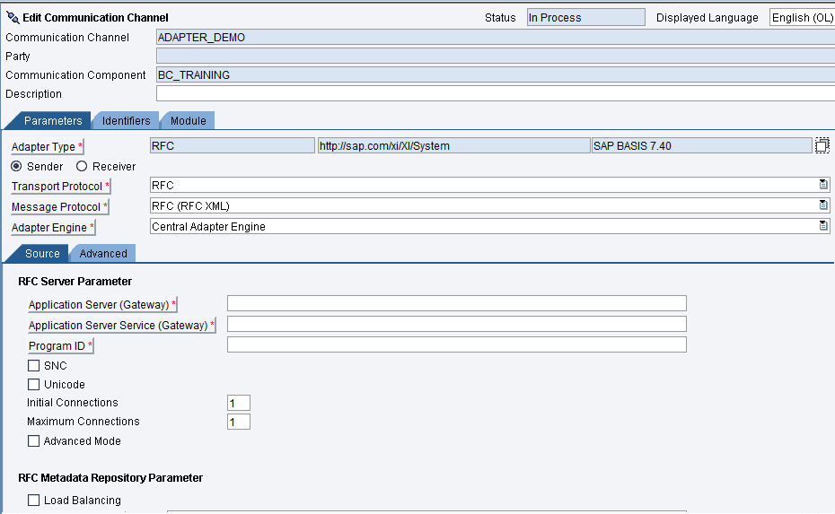
RFC Adapter

Slide 14
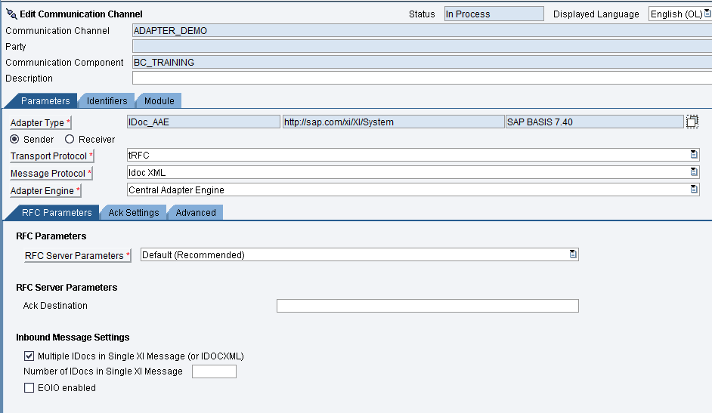
IDoc Adapter
Notes:
IDoc-Adapter: only receiver communication channel is used
Type IDoc
Exception for „normal IDoc-Processing“: report“IDX_SELECT_IDOCTYP_WITHOUT_IS“
Module Processor not used

Slide 15
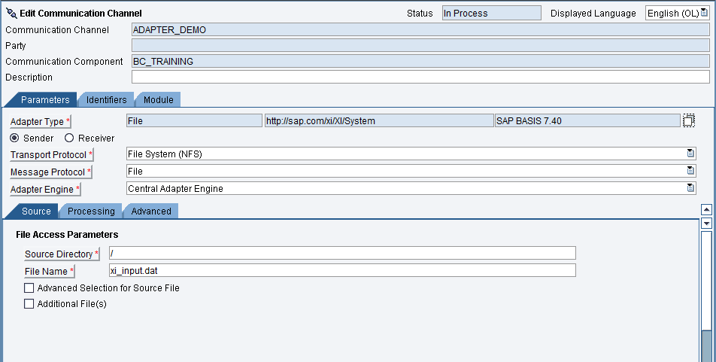
File Adapter

Slide 16
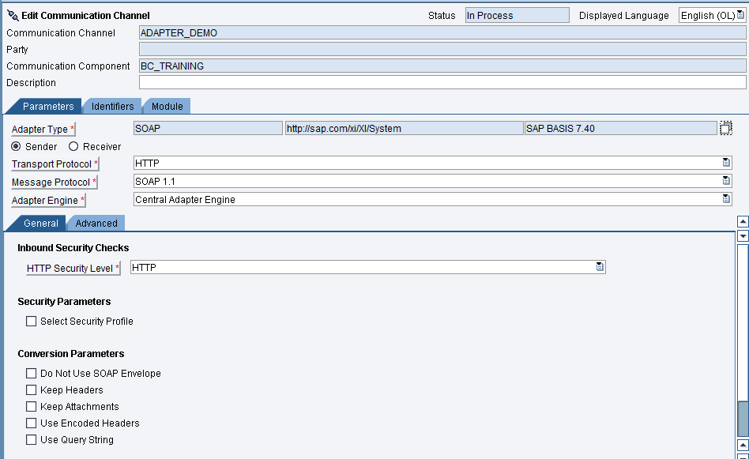
SOAP Adapter

Slide 17
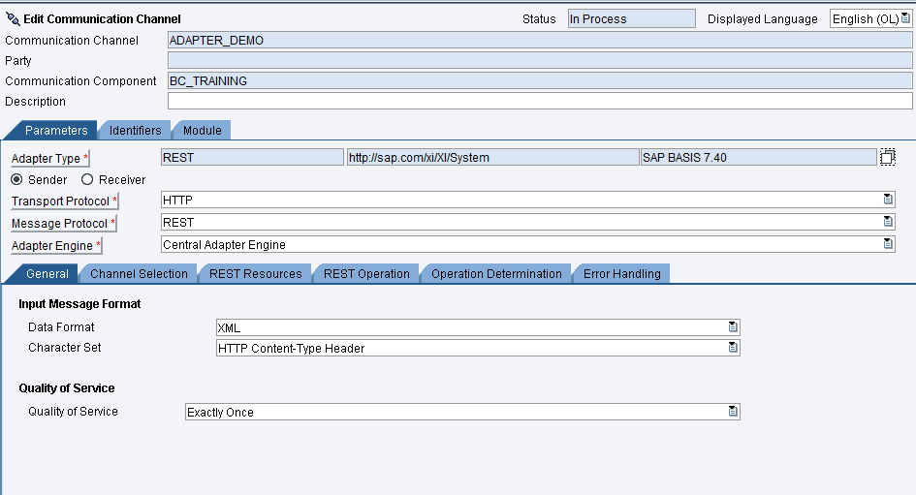
REST Adapter

Slide 18
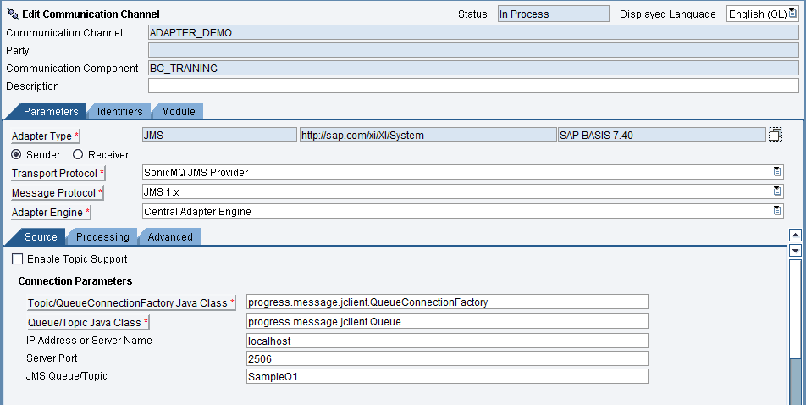
JMS Adapter

